Slide 1
MMA Welding - Typical Defects

Slide 2
KNOWLEDGE APPLICATION
Identify MMA range of application, appropriate joint preparations and potential problems to be overcome.
PRACTICAL APPLICATION
Determine how electrode coating influence droplet transfer and weld metal properties.

Slide 3
RESOURCES
Plates examples whit imperfections / defects
Norm EN ISO 17637 - Non-destructive testing of welds - Visual examination of fusion-welded joints
Norm EN ISO 5817 - Welding — Fusion-welded joints in steel, nickel, titanium and their alloys (beam welding excluded) — Quality levels for imperfections
Inspectors’ suitcase (with magnifying glass, flashlight, gage, …)

Slide 4
INSTRUCTIONS FOR CONDUCTING
THE EXERCISE
Presenting the exercise subjects
Presenting norms and plates for the Trainees
Identifying defects and imperfections of the plates by the Trainees (exercise supervised by the Trainers, helping and motivating the perform)
Result presentation of the exercise (defects and imperfections identified)
Comparative analysis – Trainees performance and Trainers outcome

Slide 5
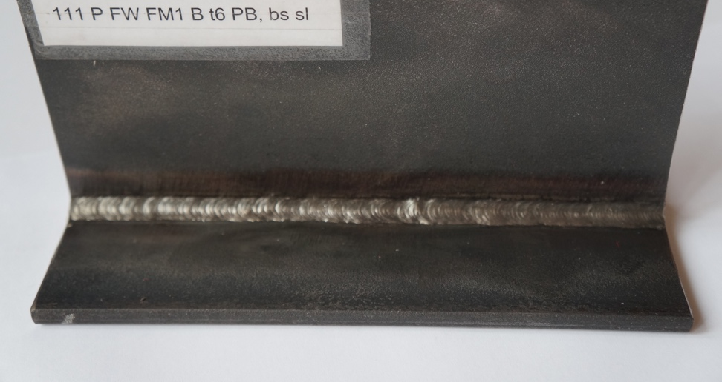
PLATE 1
Foto 1
Results/ defects
Don’t have defects.

Slide 6
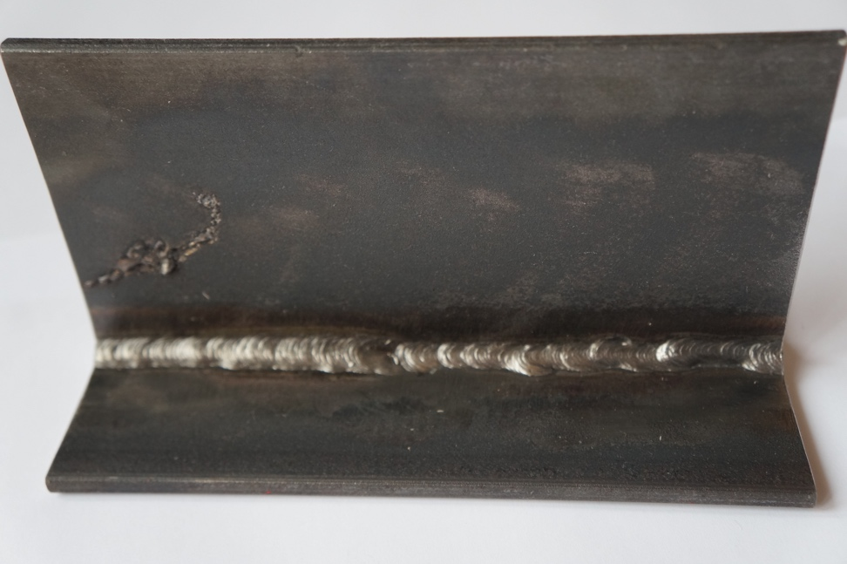
PLATE 1
Foto 2
Results/ defects
Stray arc
Poor restart / incompletely filled groove /undercut
Excessive asymmetry of fillet weld
Lack of fusion
Not Acceptable
1
2
3
4

Slide 7
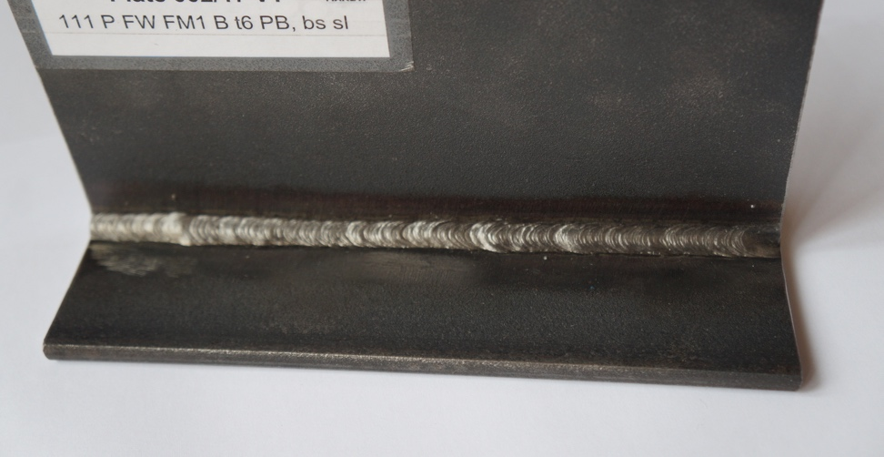
Plate 2
Foto 1
Results/ defects
Don’t have defects.

Slide 8
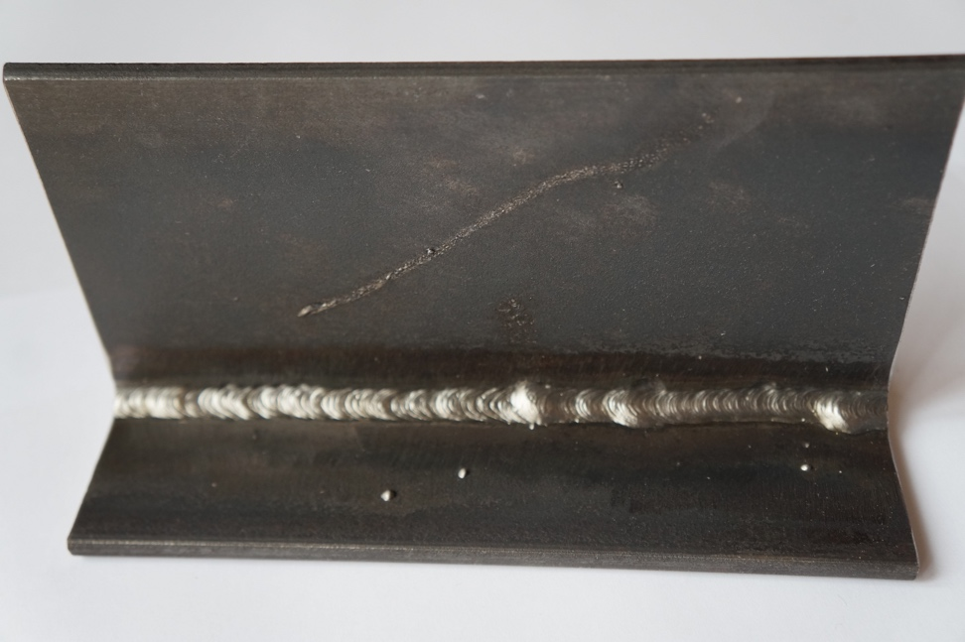
Plate 2
Foto 2
Results/ defects
Stray arc
Undercut
Excessive convexity
Undercut
Excessive convexity
Not Acceptable
1
2
3
4
5

Slide 9
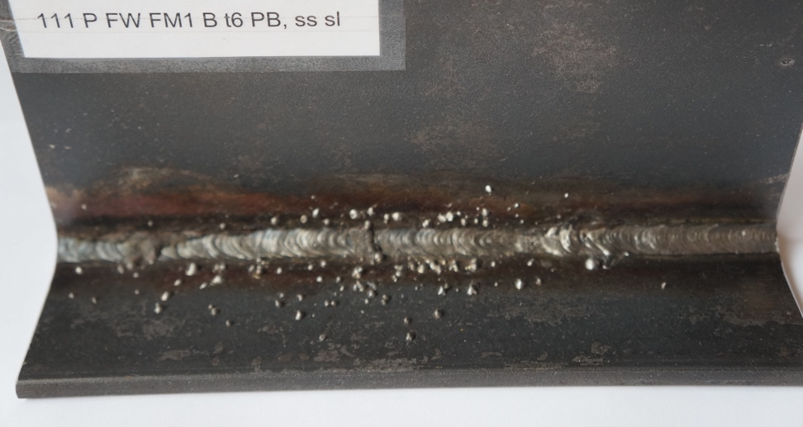
Plate 3
Foto 1
Results/ defects
Slag inclusions
Spatter
Poor restart
Surface pore
Continuous undercut
5
3
4
1
2

Slide 10
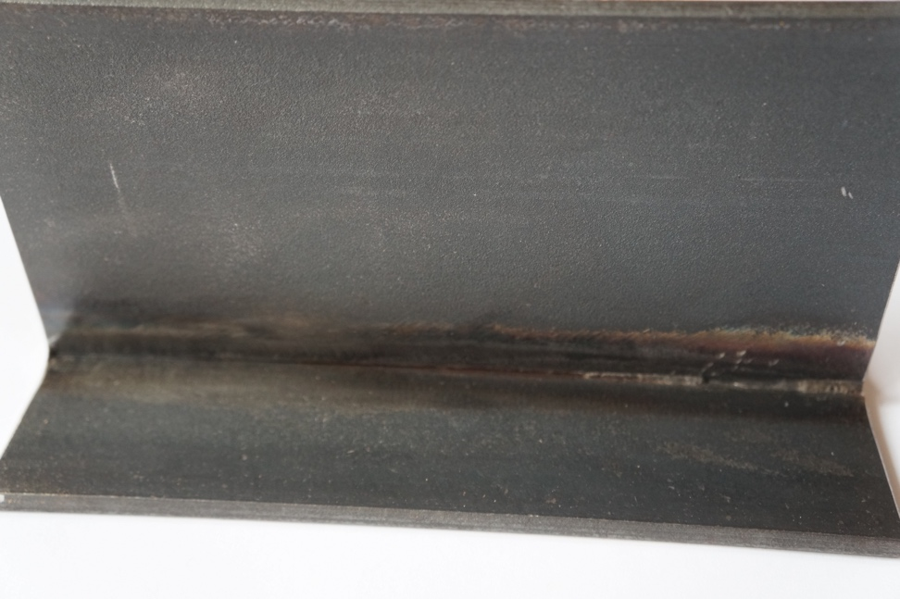
Plate 3
Foto 2
Results/ defects
Incorrect root gap for fillet welds
Slag inclusions
1
2

Slide 11
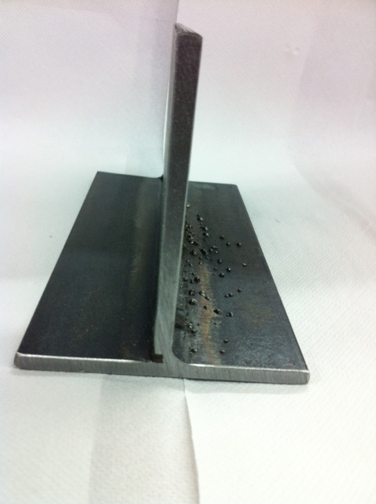
Plate 3
Foto 3
Results/ defects
Incorrect root gap for fillet welds
Spatter
Not Acceptable
2
1

Slide 12
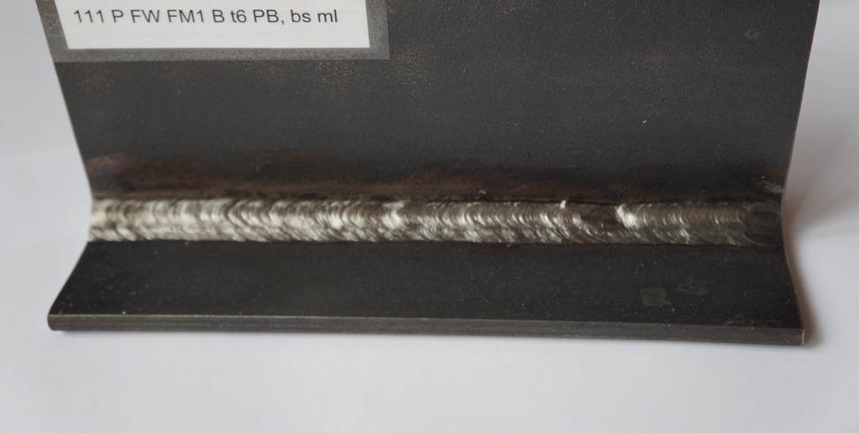
Plate 4
Foto 1
Results/ defects
Poor restart
1

Slide 13
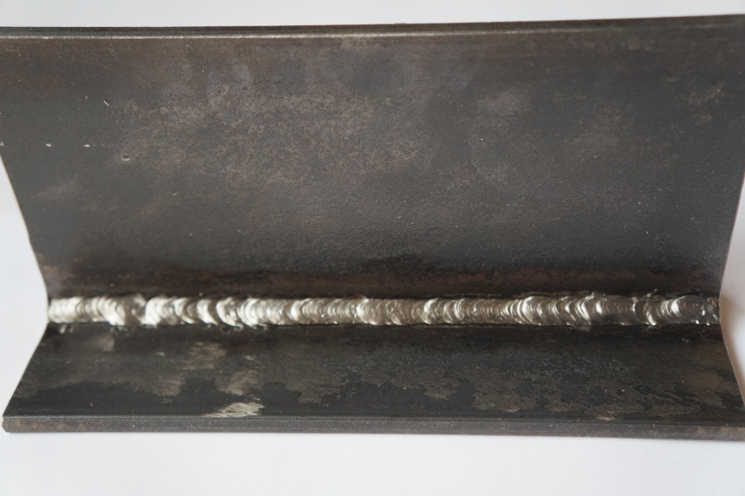
Plate 4
Foto 2
Results/ defects
Continuous undercut
Surface pore
Excessive convexity fillet weld
Not Acceptable
1
3
2

Slide 14
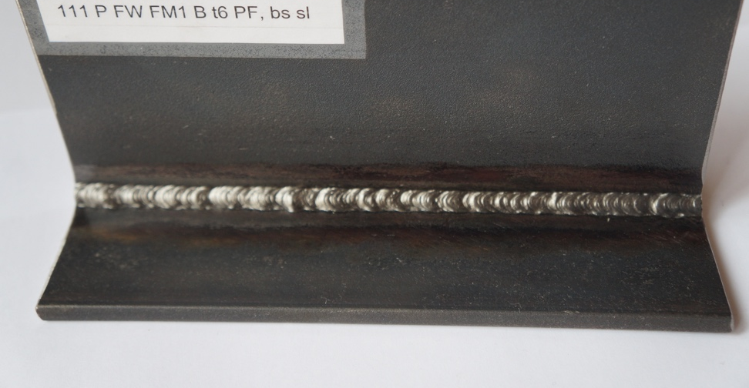
Plate 5
Foto 1
Results/ defects
Insufficient throat thickness

Slide 15
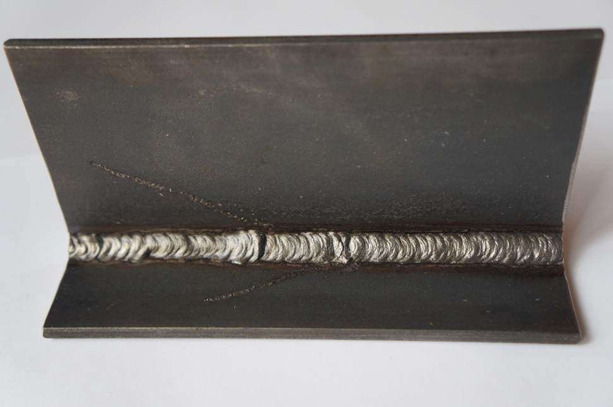
Plate 5
Foto 2
Results/ defects
Stray arc
Continuous undercut
Poor start / Excessive convexity
Stray arc
Incomplete of fusion
Poor start
Not Acceptable
1
2
3
6
5
4

